Slide 1
Text Analysis with Machine Learning
Chris DuBois
Dato, Inc.

Slide 2
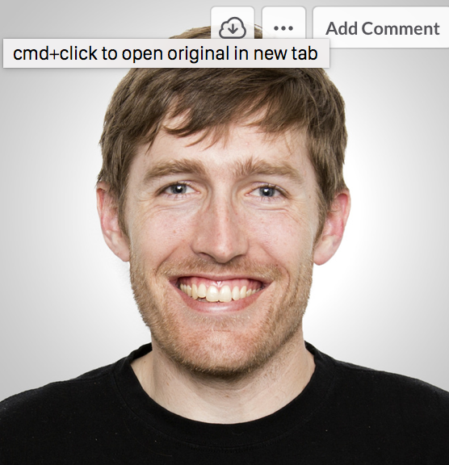
About me
Chris DuBois
Staff Data Scientist
Ph.D. in Statistics
Previously: probabilistic models of social networks and event data occurring over time.
Recently: tools for recommender systems, text analysis, feature engineering and model parameter search.
chris@dato.com
@chrisdubois

Slide 3
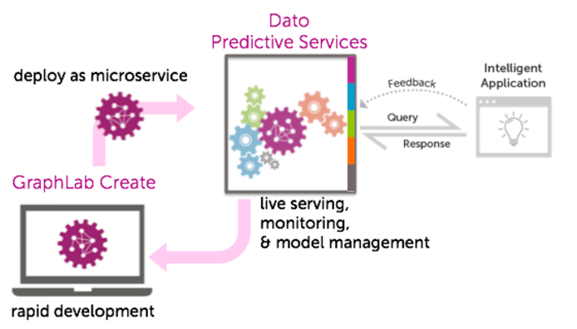
About Dato
We aim to help developers…
develop valuable ML-based applications
deploy models as intelligent microservices
Notes:
We aim to help developers…
create and grow business value with ML: Immediately create a business application using our fully customizable toolkits, and continuously and easily enhance it:
Business-task centered ML toolkits: recommenders, churn prediction, lead scoring,…, not just ML algorithms like boosted trees and deep learning.
Automated model selection, parameter optimization, and evaluation.
Painless feature engineering.
Delightful user experience for developers:
Use SFrames to manipulate multiple data types, easily create features with pre-defined transformations or easily create your own.
50+ robust ML algorithms where out-of-core computation eliminate scale pains.
Deploy models as intelligent microservices: Easily compose intelligent applications from hosted microservices, using the customer’s own infrastructure or AWS
Host any model.
Performant for production.
Model experimentation, monitoring and management.

Slide 4
Quick poll!

Slide 5
Agenda
Applications of text analysis: examples and a demo
Fundamentals
Text processing
Machine learning
Task-oriented tools
Putting it all together
Deploying the pipeline for the application
Quick survey of next steps
Advanced modeling techniques

Slide 6
Applications of text analysis

Slide 7

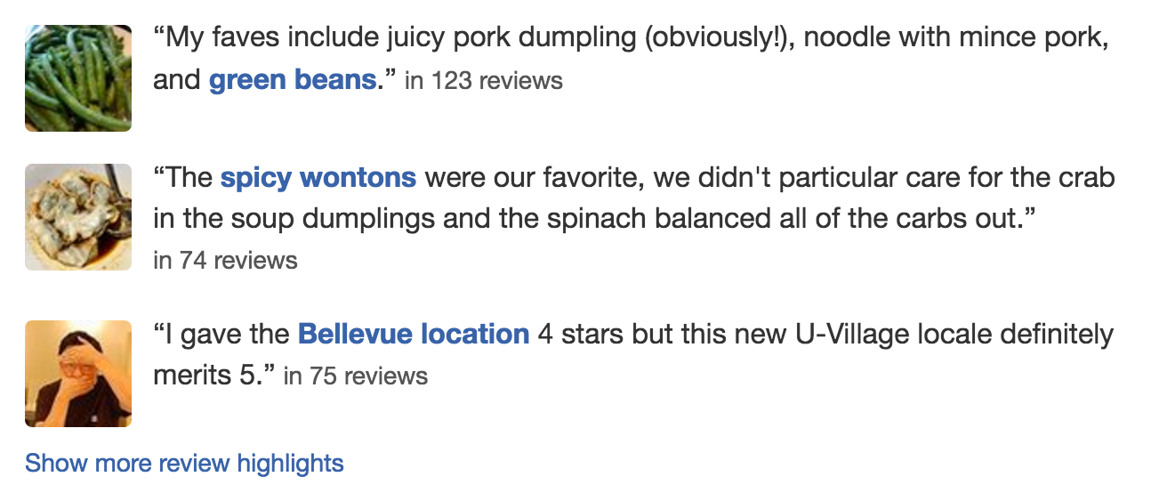
Product reviews and comments
Applications of text analysis

Slide 8
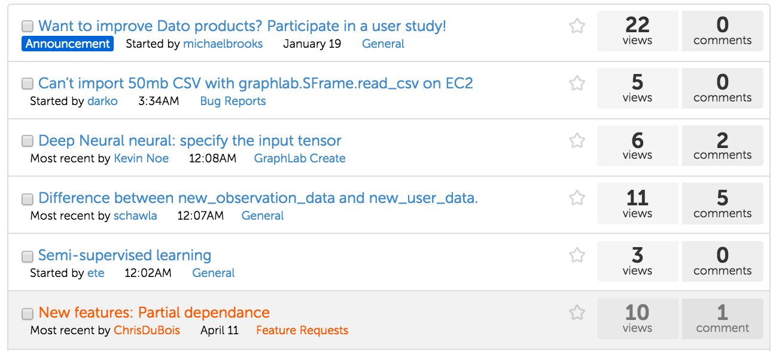
User forums and customer service chats
Applications of text analysis

Slide 9

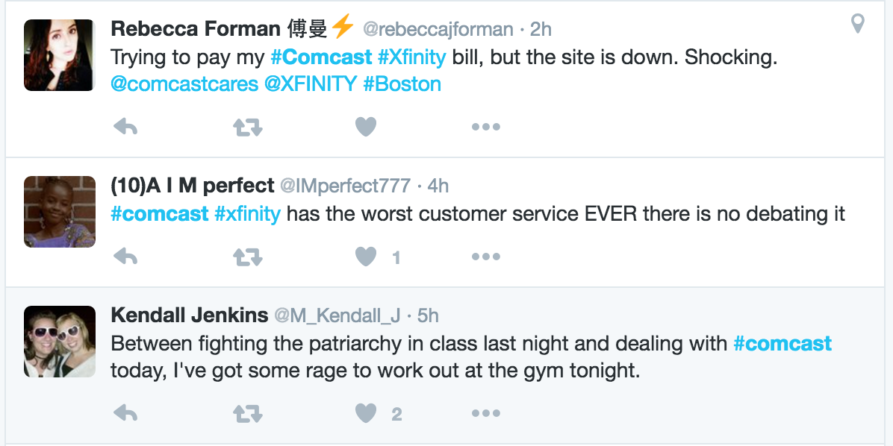
Social media: blogs, tweets, etc.
Applications of text analysis

Slide 10

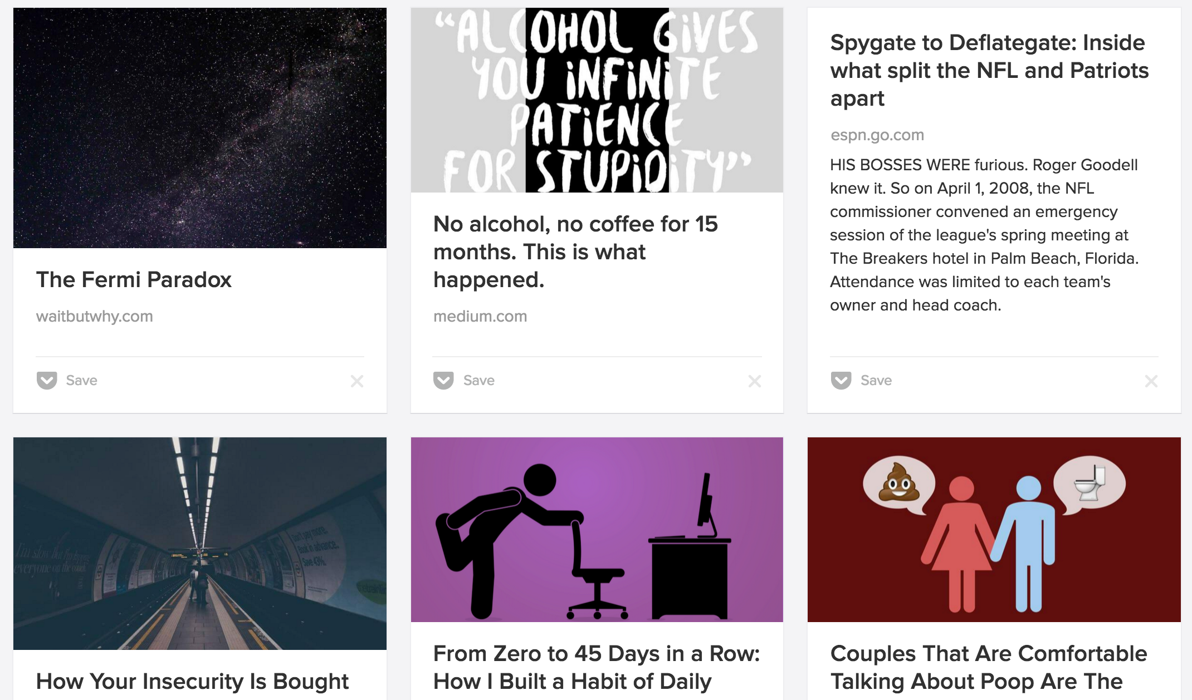
News feeds
Applications of text analysis

Slide 11

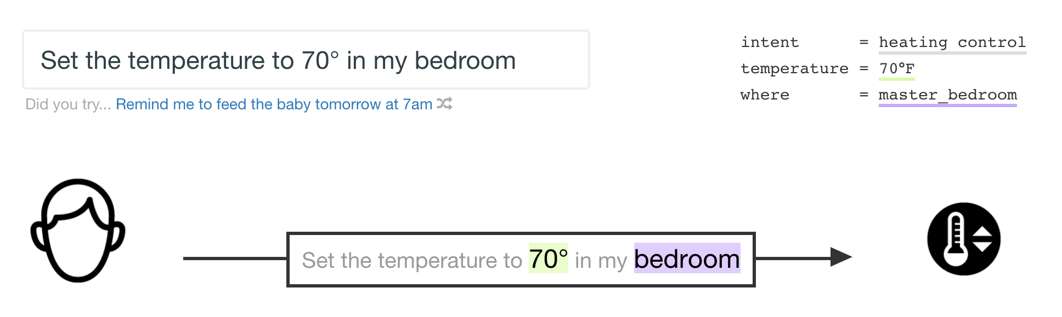
Speech recognition and chat bots
Applications of text analysis

Slide 12
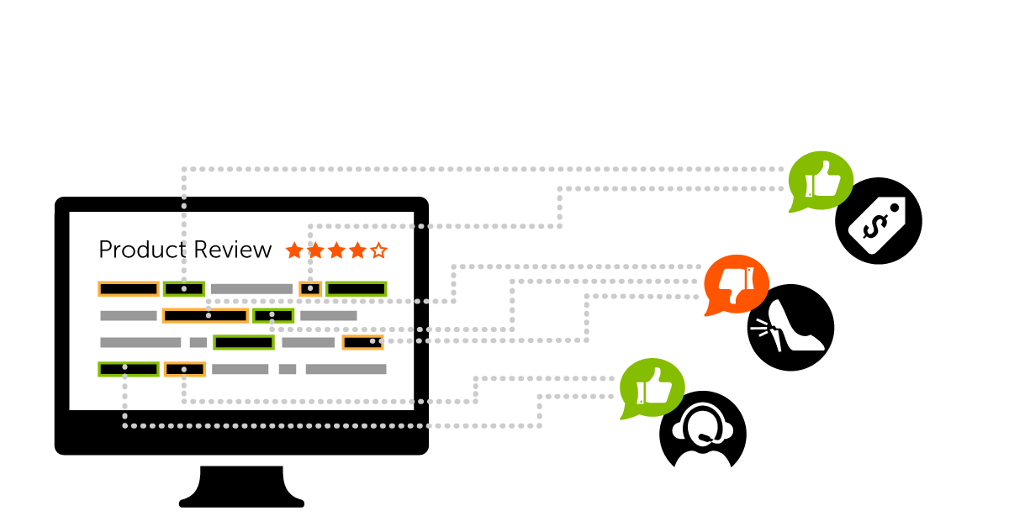
Aspect mining
Applications of text analysis

Slide 13
Quick poll!

Slide 14
Example of a product sentiment application

Slide 15
Text processing fundamentals

Slide 16
Data
id | timestamp | user_name | text
102 | 2016-04-05 9:50:31 | Bob | The food tasted bland and uninspired.
103 | 2016-04-06 3:20:25 | Charles | I would absolutely bring my friends here. I could eat those fries every …
104 | 2016-04-08 11:52 | Alicia | Too expensive for me. Even the water was too expensive.
… | … | … | …
int | datetime | str | str

Slide 17
Transforming string columns
id | text
102 | The food tasted bland and uninspired.
103 | I would absolutely bring my friends here. I could eat those fries every …
104 | Too expensive for me. Even the water was too expensive.
… | …
int | str
Tokenizer
CountWords
NGramCounter
TFIDF
RemoveRareWords
SentenceSplitter
ExtractPartsOfSpeech
stack/unstack
Pipelines

Slide 18
Convert each document into a list of tokens.
Tokenization
INPUT
“The caesar salad was amazing.”
OUTPUT
[“The”, “caesar”, “salad”, “was”, “amazing.”]

Slide 19
Compute the number of times each word occurs.
Bag of words representation
INPUT
“The ice cream was the best.”
OUTPUT
{
“the”: 2,
“ice”: 1,
“cream”: 1,
“was”: 1,
“best”: 1
}

Slide 20
Compute the number of times each set of words occur.
N-Grams (words)
INPUT
“Give it away, give it away, give it away now”
OUTPUT
{
“give it”: 3,
“it away”: 3,
“away give”: 2,
“away now”: 1
}

Slide 21
Compute the number of times each set of characters occur.
N-Grams (characters)
INPUT
“mississippi”
OUTPUT
{
“mis”: 1,
“iss”: 2,
“sis”: 1,
“ssi”: 2,
“sip”: 1,
...
}

Slide 22
Rescale word counts to discriminate between common and distinctive words.
TF-IDF representation
INPUT
{“this”: 1, “is”: 1, “a”: 2, “example”: 3}
OUTPUT
{“this”: .3, “is”: .1, “a”: .2, “example”: .9}
Low scores for words that are common among all documents
High scores for rare words occurring often in a document

Slide 23
Remove rare words (or pre-defined stopwords).
Remove rare words
INPUT
“I like green eggs3 and ham.”
OUTPUT
“I like green and ham.”

Slide 24
Convert each document into a list of sentences.
Split by sentence
INPUT
“It was delicious. I will be back.”
OUTPUT
[“It was delicious.”, “I will be back.”]

Slide 25
Identify particular parts of speech.
Extract parts of speech
INPUT
“It was delicious. I will go back.”
OUTPUT
[“delicious”]

Slide 26
Rearrange the data set to “stack” the list column.
stack
id | text
102 | [“The food was great.”, “I will be back.”]
103 | [“I would absolutely bring my friends here.”, “I could eat those fries every day.”]
104 | [“Too expensive for me.”]
… | …
int | list
id | text
102 | “The food was great.”
102 | “I will be back.”
103 | “I would absolutely bring my friends here.”
… | …
int | str

Slide 27
Rearrange the data set to “unstack” the string column.
unstack
id | text
102 | [“The food was great.”, “I will be back.”]
103 | [“I would absolutely bring my friends here.”, “I could eat those fries every day.”]
104 | [“Too expensive for me.”]
… | …
int | list
id | text
102 | “The food was great.”
102 | “I will be back.”
103 | “I would absolutely bring my friends here.”
… | …
int | str

Slide 28
Combine multiple transformations to create a single pipeline.
Pipelines
from graphlab.feature_engineering import
WordCounter, RareWordTrimmer
f = gl.feature_engineering.create(sf,
[WordCounter, RareWordTrimmer])
f.fit(data)
f.transform(new_data)

Slide 29
Machine learning toolkits

Slide 30
matches unstructured text queries to a set of strings
Task-oriented toolkits and building blocks
Autotagger
=
=
Nearest neighbors +
NGramCounter

Slide 31

Nearest neighbors
Query
Reference
id | TF-IDF of text
int | dict
id | TF-IDF of text
int | dict
NearestNeighborsModel
Result
query_id | reference_id | score | rank
int | int | float | int

Slide 32
Autotagger = Nearest Neighbors + Feature Engineering
Query
Reference
id | char ngrams | …
int | dict
id | char ngrams | …
int | dict | …
AutotaggerModel
Result
query_id | reference_id | score | rank
int | int | float | int

Slide 33
Task-oriented toolkits and building blocks
=
SentimentAnalysis
predicts positive/negative sentiment in unstructured text
=
WordCounter +
Logistic Classifier

Slide 34
Logistic classifier
Training data
New data
label | feature(s)
int/str | int/float/str/dict/list
label | feature(s)
int/str | int/float/str/dict/list
LogisticClassifier
scores
float
Probability label=1

Slide 35
Sentiment analysis = LogisticClassifier + Feature Engineering
Training data
New data
label | bag of words
int/str | dict
label | bag of words
int/str | dict
SentimentAnalysis
scores
float
Sentiment scores
(probability label = 1)

Slide 36
Product sentiment toolkit
>>> m = gl.product_sentiment.create(sf, features=['Description'], splitby='sentence')
>>> m.sentiment_summary(['billing', 'cable', 'cost', 'late', 'charges', 'slow'])
+---------+----------------+-----------------+--------------+
| keyword | sd_sentiment | mean_sentiment | review_count |
+---------+----------------+-----------------+--------------+
| cable | 0.302471264675 | 0.285512408978 | 1618 |
| slow | 0.282117103769 | 0.243490314737 | 369 |
| cost | 0.283310577512 | 0.197087019219 | 291 |
| charges | 0.164350792173 | 0.0853637431588 | 1412 |
| late | 0.119163914305 | 0.0712757752753 | 2202 |
| billing | 0.159655783707 | 0.0697454360245 | 583 |
+---------+----------------+-----------------+--------------+

Slide 37
Code for deploying the demo

Slide 38
Advanced topics in modeling text data

Slide 39
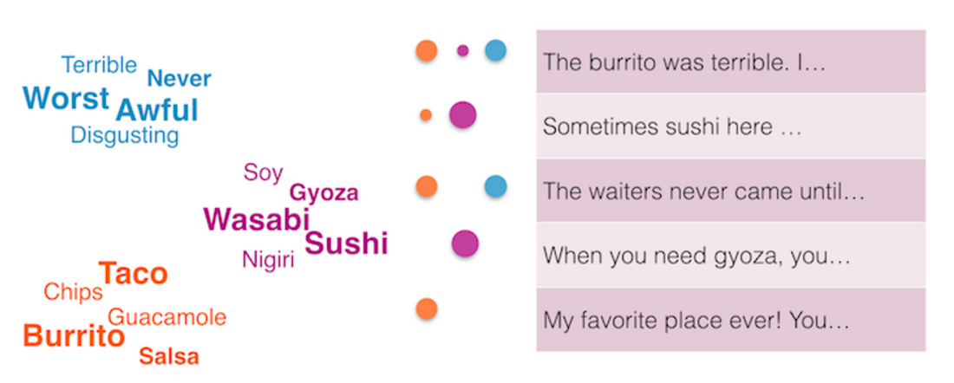
Cluster words according to their co-occurrence in documents.
Topic models

Slide 40
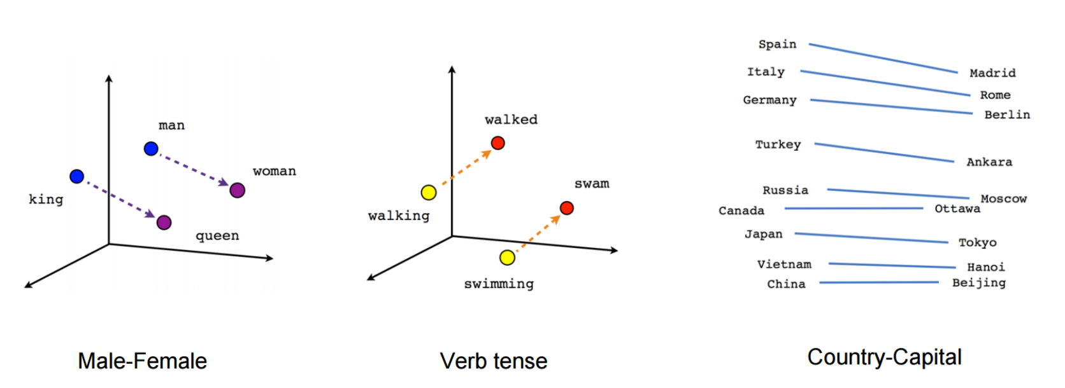
Embeddings where nearby words are used in similar contexts.
Word2vec
Image: https://www.tensorflow.org/versions/r0.7/tutorials/word2vec/index.html

Slide 41
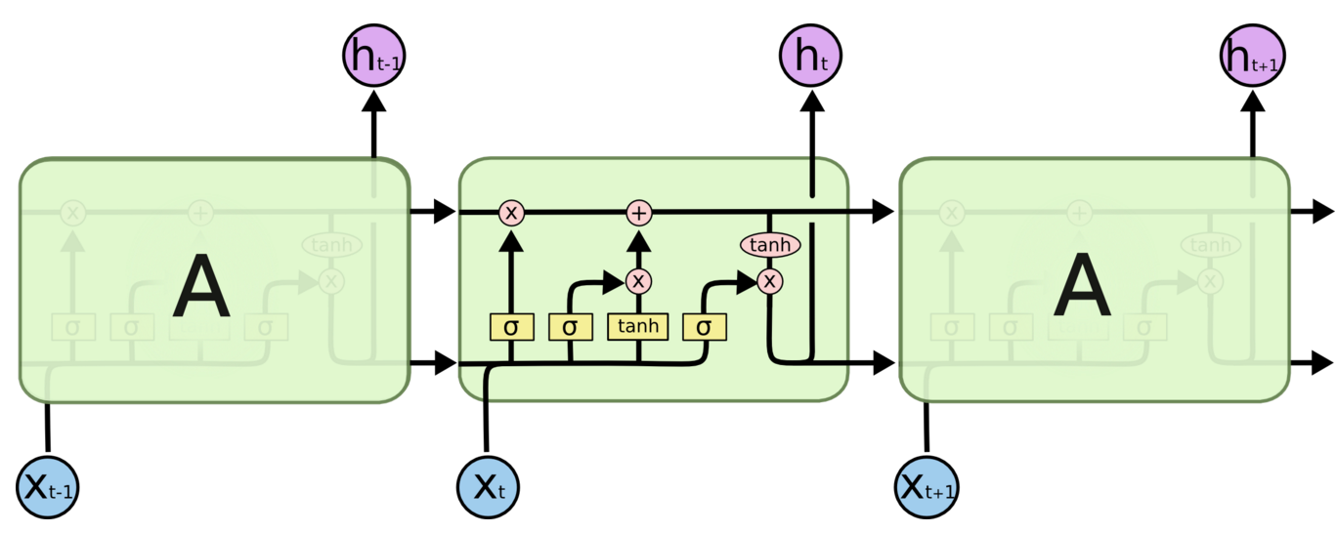
Train a neural network to predict the next word given previous words.
LSTM (Long-Short Term Memory)
Image: http://colah.github.io/posts/2015-08-Understanding-LSTMs/

Slide 42
Conclusion
Applications of text analysis: examples and a demo
Fundamentals
Text processing
Machine learning
Task-oriented tools
Putting it all together
Deploying the pipeline for the application
Quick survey of next steps
Advanced modeling techniques

Slide 43
Next steps
Webinar material? Watch for an upcoming email!
Help getting started? Userguide, API docs, Forum
More webinars? Benchmarking ML, data mining, and more
Contact: Chris DuBois, chris@dato.com

Slide 44
Python tools for text analysis

Slide 45

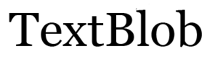








Unifying text analysis
Parsing (tokens, sentences, parts of speech)
Feature engineering (ngrams, tf-idf)
Pre-trained models
Topic models
RNNs, LSTMs
￼

